Slide 1
WPF Data Binding
Technical presentation milestone
Chris devisser (20521027)
2015-07-08

Slide 2
Presentation Information
General Questions:
Note the slide number
Ask at the end
Syntax Questions:
Some C# 6 features are used
If syntax not covered, ask right away
Slides and Code:
Available on Github: https://github.com/chrisdevisser/TPM

Slide 3
Outline
Background
Data Binding
Demo: Basic Math
Summary
Questions

Slide 4
Background
WPF
MVVM
Observer Pattern

Slide 5
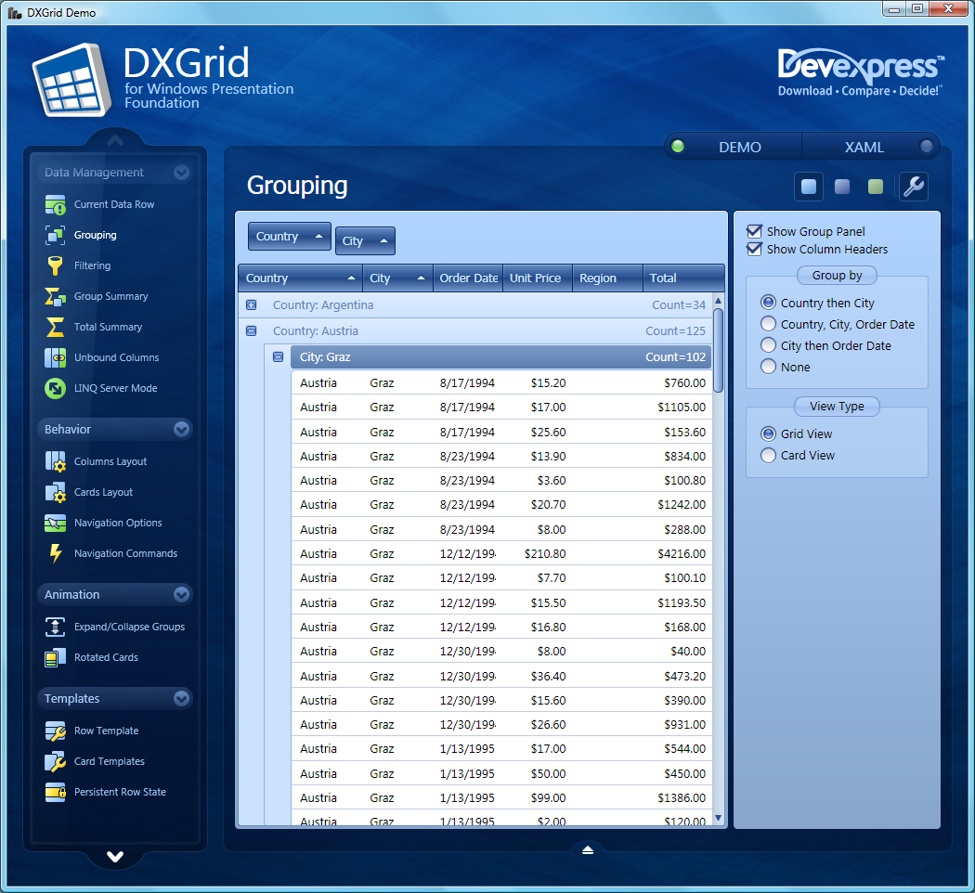
WPF
Windows Presentation Foundation
User interface framework
XAML
Windows Forms
Source: https://community.devexpress.com/blogs/thinking/DXGrid%20for%20WPF.png

Slide 6
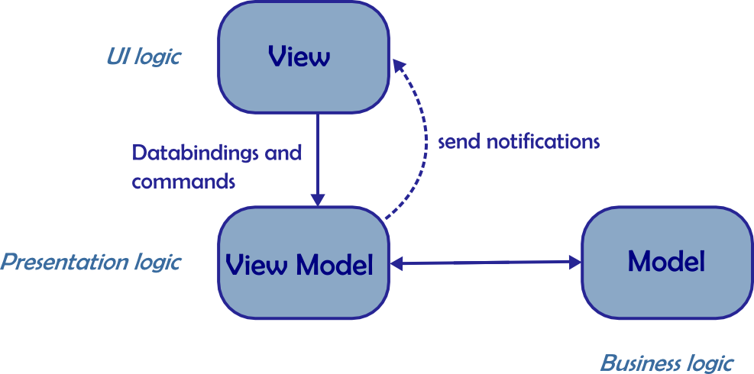
MVVM
Model – View – View Model
Decoupled logic
Little to no UI code
MVP on steroids
Testable
Data binding and commands
Source: https://benoitpatra.files.wordpress.com/2014/03/mvvm1.png

Slide 7
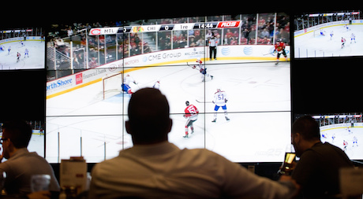
Observer Pattern
Decouples observer and subject
INotifyPropertyChanged
Core of MVVM
Source: http://www.hockeyinsideout.com/wp-content/uploads/2014/10/TV.jpg

Slide 8
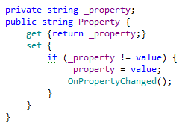
INotifyPropertyChanged Example
Provide a PropertyChanged event and OnPropertyChanged handler
Notify observers when properties are changed

Slide 9
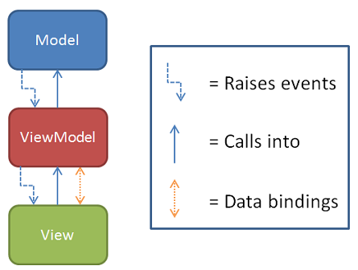
Data Binding
View model exposes properties
View binds directly to those properties
Value conversions happen if needed
That’s it!
Source: http://rarcher.azurewebsites.net/Images/binding00b.png

Slide 10

Preparing to Bind
We need to set up the view’s data context (the view model)

Slide 11
Simple Bindings
We just need to specify the name of the property to which to bind

Slide 12
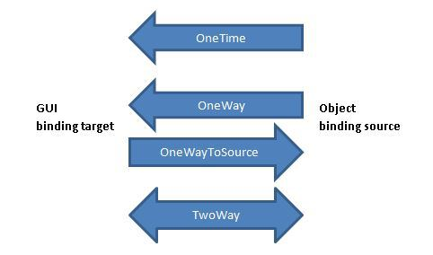
Binding Modes
One way (default)
Two way
One way to source
Source: https://csharphardcoreprogramming.files.wordpress.com/2014/02/mode.jpg

Slide 13
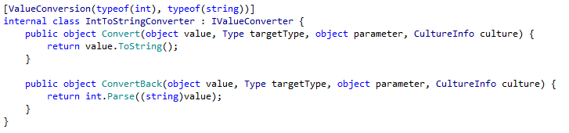
Value Conversions
The binding might not be a perfect match (e.g., different types)

Slide 14
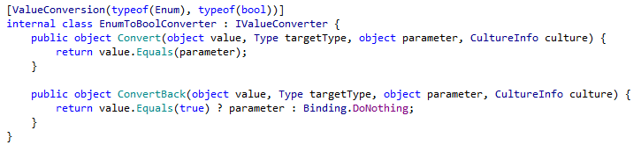
Value Conversions
The binding might not be a perfect match (e.g., different types)

Slide 15
Demo: Basic Math
See provided code and program
Skip demo slides

Slide 16
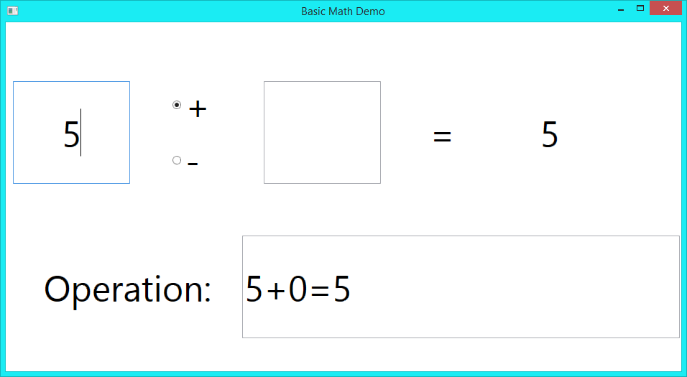
Demo: Basic Math

Slide 17
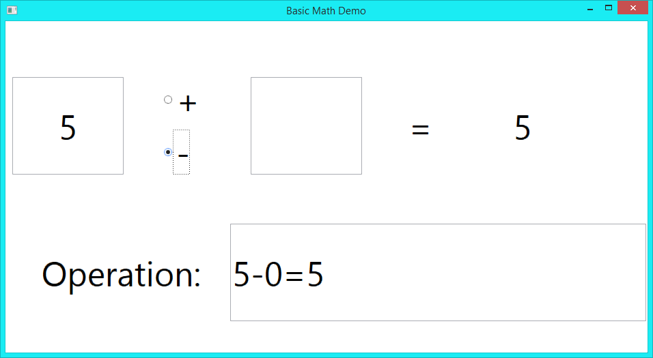
Demo: Basic Math

Slide 18
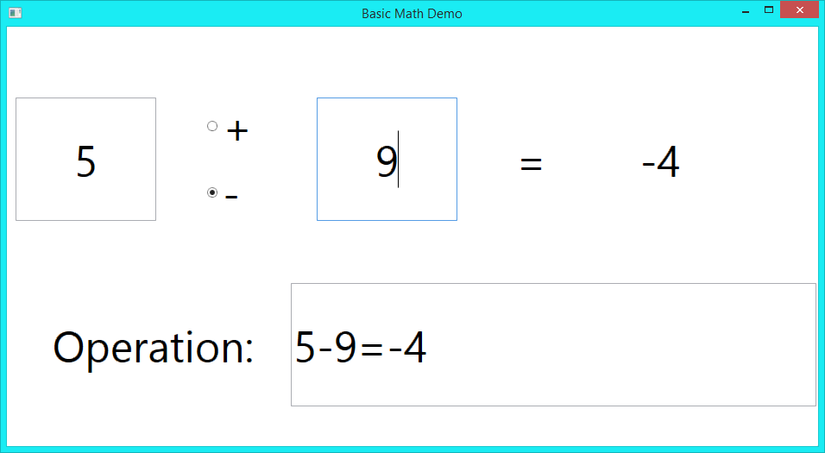
Demo: Basic Math

Slide 19
Demo: Basic Math

Slide 20
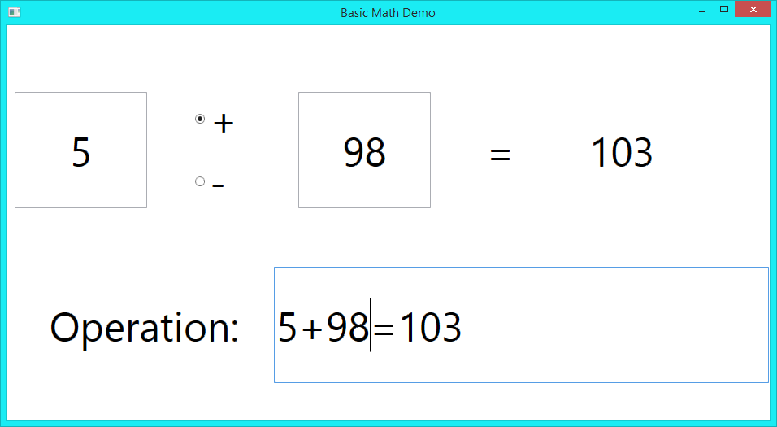
Demo: Basic Math

Slide 21
Summary
Data bindings:
Are powerful
Do not require code to set up
UI designers do not need to write C#
Contribute to easy creation of reactive UIs

Slide 22

Questions
Source: http://images.clipartpanda.com/cool-question-marks-QuestionMarks.jpg

